Slide 1
POLYVEST® eCO
Pathways to a more sustainable future in the rubber industry
28-29.06.2023 I Dr. Sara Liébana Viñas

Slide 2
Agenda
Evonik
Business Line Coating & Adhesive Resins
POLYVEST® eCO
Q&A Session

Slide 3

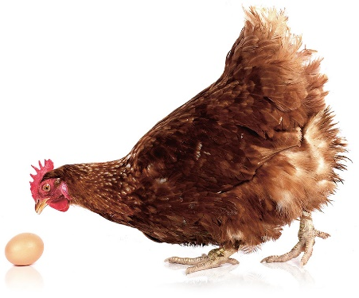
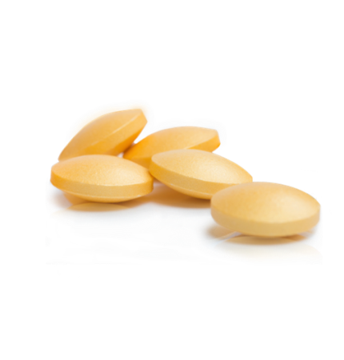
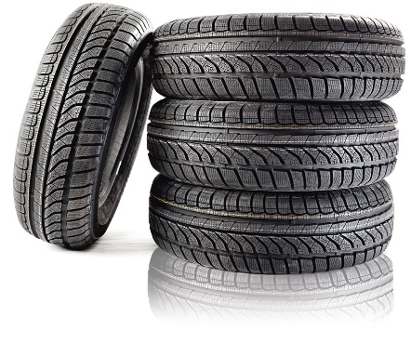

No product is so perfect
that you can’t improve it.
more fuel-efficient
fluffier
bouncier
healthier
more effective
TIRES
TOWELS
MATTRESSES
NUTRITION
TABLETS
Notes:
No product is so perfect that you can’t improve it.
Car tires, mattresses, pills, animal food – we don’t manufacture these end products. But Evonik is in all of them – and in many others as well.
We often contribute just small quantities, but these contributions make all the difference.
Because Evonik makes tires more fuel-efficient, mattresses fluffier, pills more effective, and animal food healthier.

Slide 4
To make that happen, we go beyond
CHEMISTRY
Notes:
To make that happen, we at Evonik go beyond chemistry.
We interconnect our competencies and perspectives – from chemistry to biotechnology, physics, and materials science to other disciplines outside the natural sciences.
We collaborate with strong partners to drive innovation.
We’re committed to sustainability – in our product portfolio, our investments, and our innovation management.
In this way, we create profitable and sustainable solutions.

Slide 5
That’s specialty chemicals.
And that’s where we’re among the best in class.
€18.5 billion
sales*
€2.49 billion
adjusted EBITDA*
€1.17
dividend per share**
13.5 %
adjusted EBITDA margin*
~80%
of sales from
leading market positions
€856 million
investment in tangible assets
>34,000
employees
108
nationalities
€2.26
adjusted earnings
per share*
* Fiscal 2022, ongoing activities
** Proposal to the Annual General Meeting in May 2023
Notes:
That’s specialty chemicals. And that’s where we’re among the best in class – as you can see from the facts and figures here.
Our customer proximity and leading market positions give us the advantage.

Slide 6
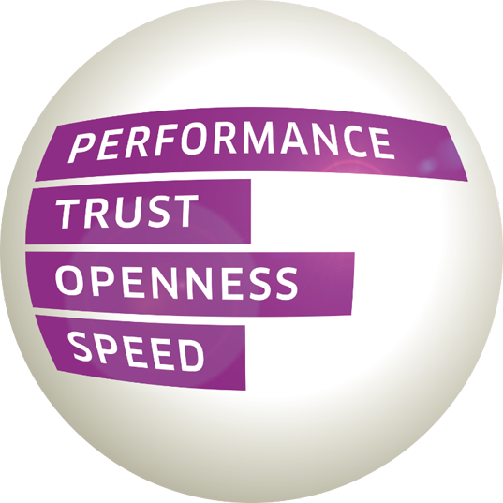



What drives us. What makes us strong. What we want to achieve – and how.
LEADING BEYOND CHEMISTRY
TO IMPROVE LIFE, TODAY AND TOMORROW
OUR PURPOSE
Strategy
Structure
Culture
Executive Board
Divisions
Specialty
Additives
Nutrition &
Care
Smart
Materials
Performance
Materials
Technology & Infrastructure
Profitable
Growth
Regions
Functions
We intend to become the best specialty chemicals company in the world
OUR VISION
Notes:
At Evonik, a shared drive unites us all: Leading beyond chemistry to improve life, today and tomorrow. That is our purpose, that is what we stand for.
We achieve this …
with a single shared strategy that helps us to keep growing and take on a leading role in the future markets.
with a structure that gives Evonik more speed and impact
and with a culture that embodies our strengths.
In this way, we will create the best specialty chemicals company in the world – our shared vision.

Slide 7
Organizational structure
Executive Board
Specialty
Additives
Nutrition &
Care
Smart
Materials
Performance
Materials
Technology &
Infrastructure
Coating Additives
Crosslinkers
Comfort & Insulation
Interface & Performance
Oil Additives
Health Care
Care Solutions
Animal Nutrition
Silica
Silane
Active Oxygens
Catalysts
High Performance Polymers
Coating & Adhesive Resins
Baby Care
Performance Intermediates
Functional Solutions
Energy & Utilities
Technical Service
Process Technology & Engineering
Logistics
Site Management

Slide 8
Agenda
Evonik
Business Line Coating & Adhesive Resins
POLYVEST® eCO
Q&A Session

Slide 9
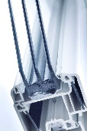
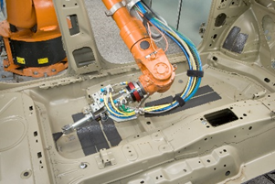


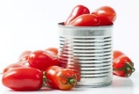



Business Line Coating & Adhesive Resins
Technology platforms
Dr. Jürgen Herwig
Thorsten Marin
Polybutadiene
Polyacrylate
Polyester
Amorphous
Poly-α-Olefin
Brands
POLYVEST®
DEGACRYL® DEGALAN® DYNACOLL®
DYNACOLL®, DYNAPOL®
VESTOPLAST® (“hotmelts”)
Markets
Automotive
Window Glazing
Electrical Insulation
Tires & Rubber
Heat Sealing
Reactive Hot Melts
Medical Applications
Food & Beverage Can
Flexible Packaging
Construction
Appliances
Automotive
Packaging
Hygiene applications
Construction
Assets
Marl
Darmstadt
Witten, Shanghai, Marl
Marl

Slide 10
We design polymers.
Smart solutions for a sustainable future.
Amorphous Poly-Alpha-Olefins
Production Sites
Technology Platforms
Brands
Germany
Darmstadt | Marl | Witten
China
Shanghai
Five technology platforms form the basis of our Coating & Adhesive Resins business line.
Our product portfolio designed for the Adhesives & Sealants Industry.
Amorphous poly-alpha-olefins
Liquid polybutadienes
Polyesters
Specialty acrylics
VESTOPLAST®
POLYVEST®
DYNAPOL® & DYNACOLL®
DEGACRYL®
Industries & Applications
Coatings
Can coatings
Coil coatings
Flexible packaging
Heat seal packaging
Adhesives & Sealants
Automotive
Construction
Electronics
Hygiene
Packaging
Rheology modifier
Woodworking
Medical & Ceramics
Dental applications
Bone cement
Porous molds
Resins for orthopedics
Rubber
Tires
Mechanical rubber goods

Slide 11
Agenda
Evonik
Business Line Coating & Adhesive Resins
POLYVEST® eCO
Q&A Session

Slide 12
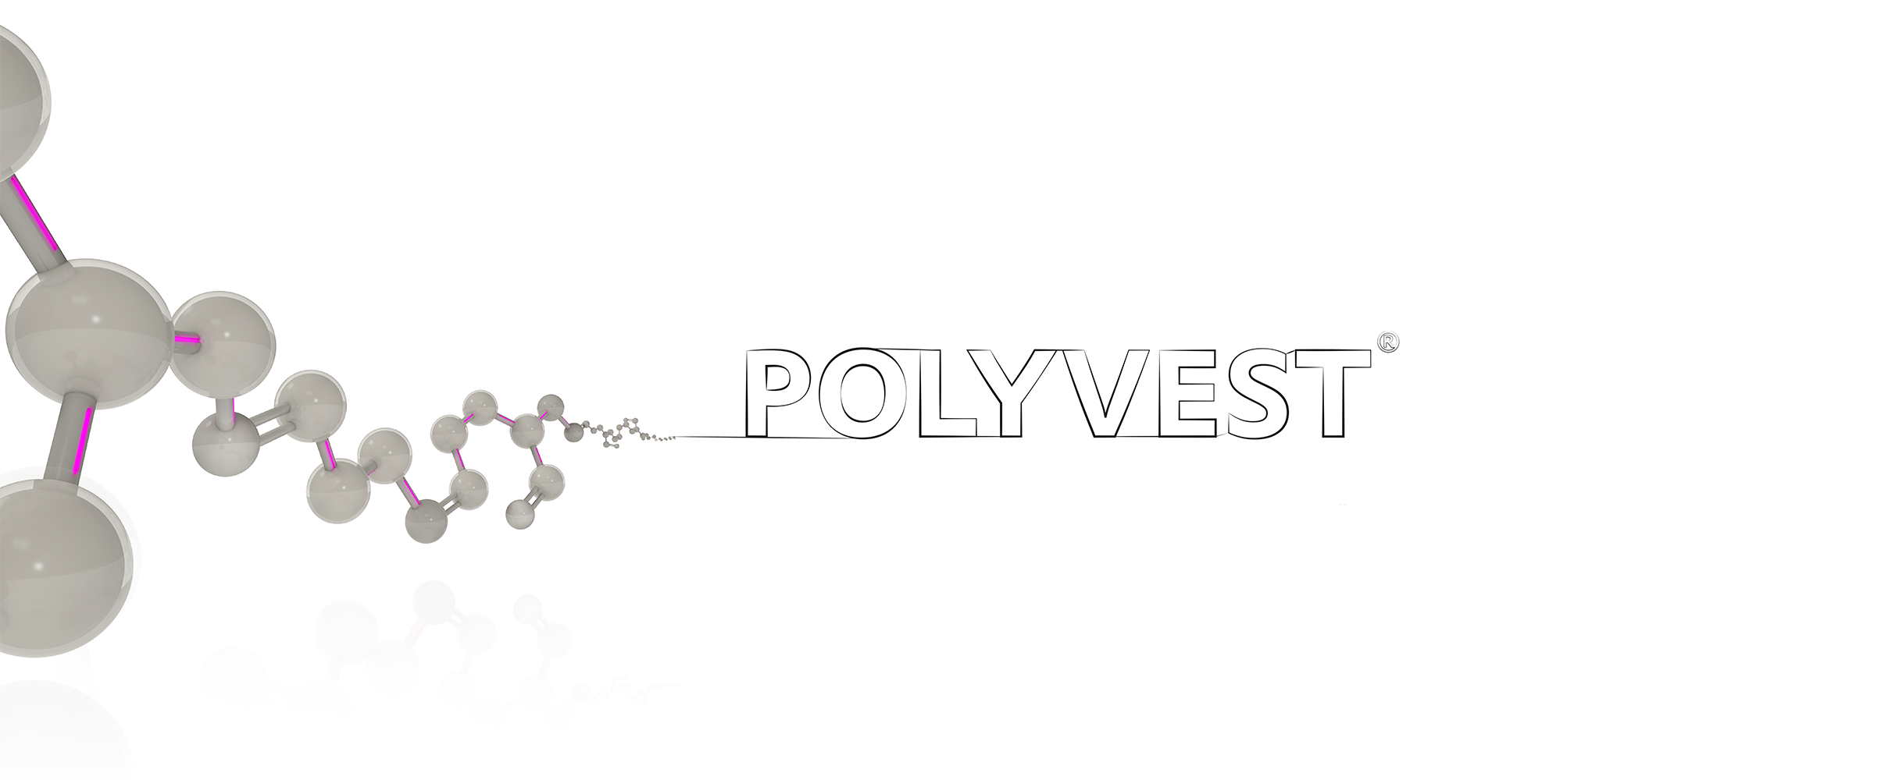
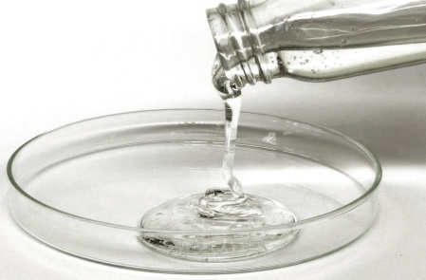
Advantages of liquid polybutadienes
Due to its microstructure POLYVEST® grades are highly reactive crosslinking binders or used as additives providing properties including:
  Low viscosity
  Excellent chemical resistance to acids and bases
  High water resistance
  Excellent electrical insulation properties
  Low temperature flexibility
  Low moisture and oxygen permeability

Slide 13
Markets and applications
POLYVEST® grades are used in a broad field of applications.
Automotive applications
Adhesives & sealants for body- & paint shop applications, structural adhesives, head lamp adhesives
Rubber
binder or plasticizer in rubber or tire compounds, modifier in carbon-black filled EPDM compounds
Electronics
electrical insulation and potting compounds
Coatings
air drying improver of vegetable oils, defoamers, impregnations, modifier in resin systems
Printing & inks
offset printing inks, flexible printing plates
Construction
binder for dusty and dry quartz sand, binder for soil stabilization, modifier of silicone sealants
Polymer modification
chlorinated rubbers, electro coatings
Plastics
cell opener or release agents for PU foams
Notes:
Zwischen ECS und 1. Juli

Slide 14
Introduction
POLYVEST® product range for the Tire & Rubber Industry
Pure Liquid Rubbers
Functionalized Liquid Rubbers
POLYVEST® 110
POLYVEST® 130 S
POLYVEST® MA 75
POLYVEST® HT
x = 1 %, y + z = 99 %
x = 1 %, y + z = 99 %
x = 22 %, y = 58 %, z = 20 %
POLYVEST® EP MV (mid Vinyl)
POLYVEST® ST-E 60 & ST-E 100
x = 61 %, y + z = 39 %
Silane functionality: ≈1.5 & 2.5
For more info & other POLYVEST® grades, please refer the following link: https://adhesive-resins.evonik.com/en/products/polyvest

Slide 15
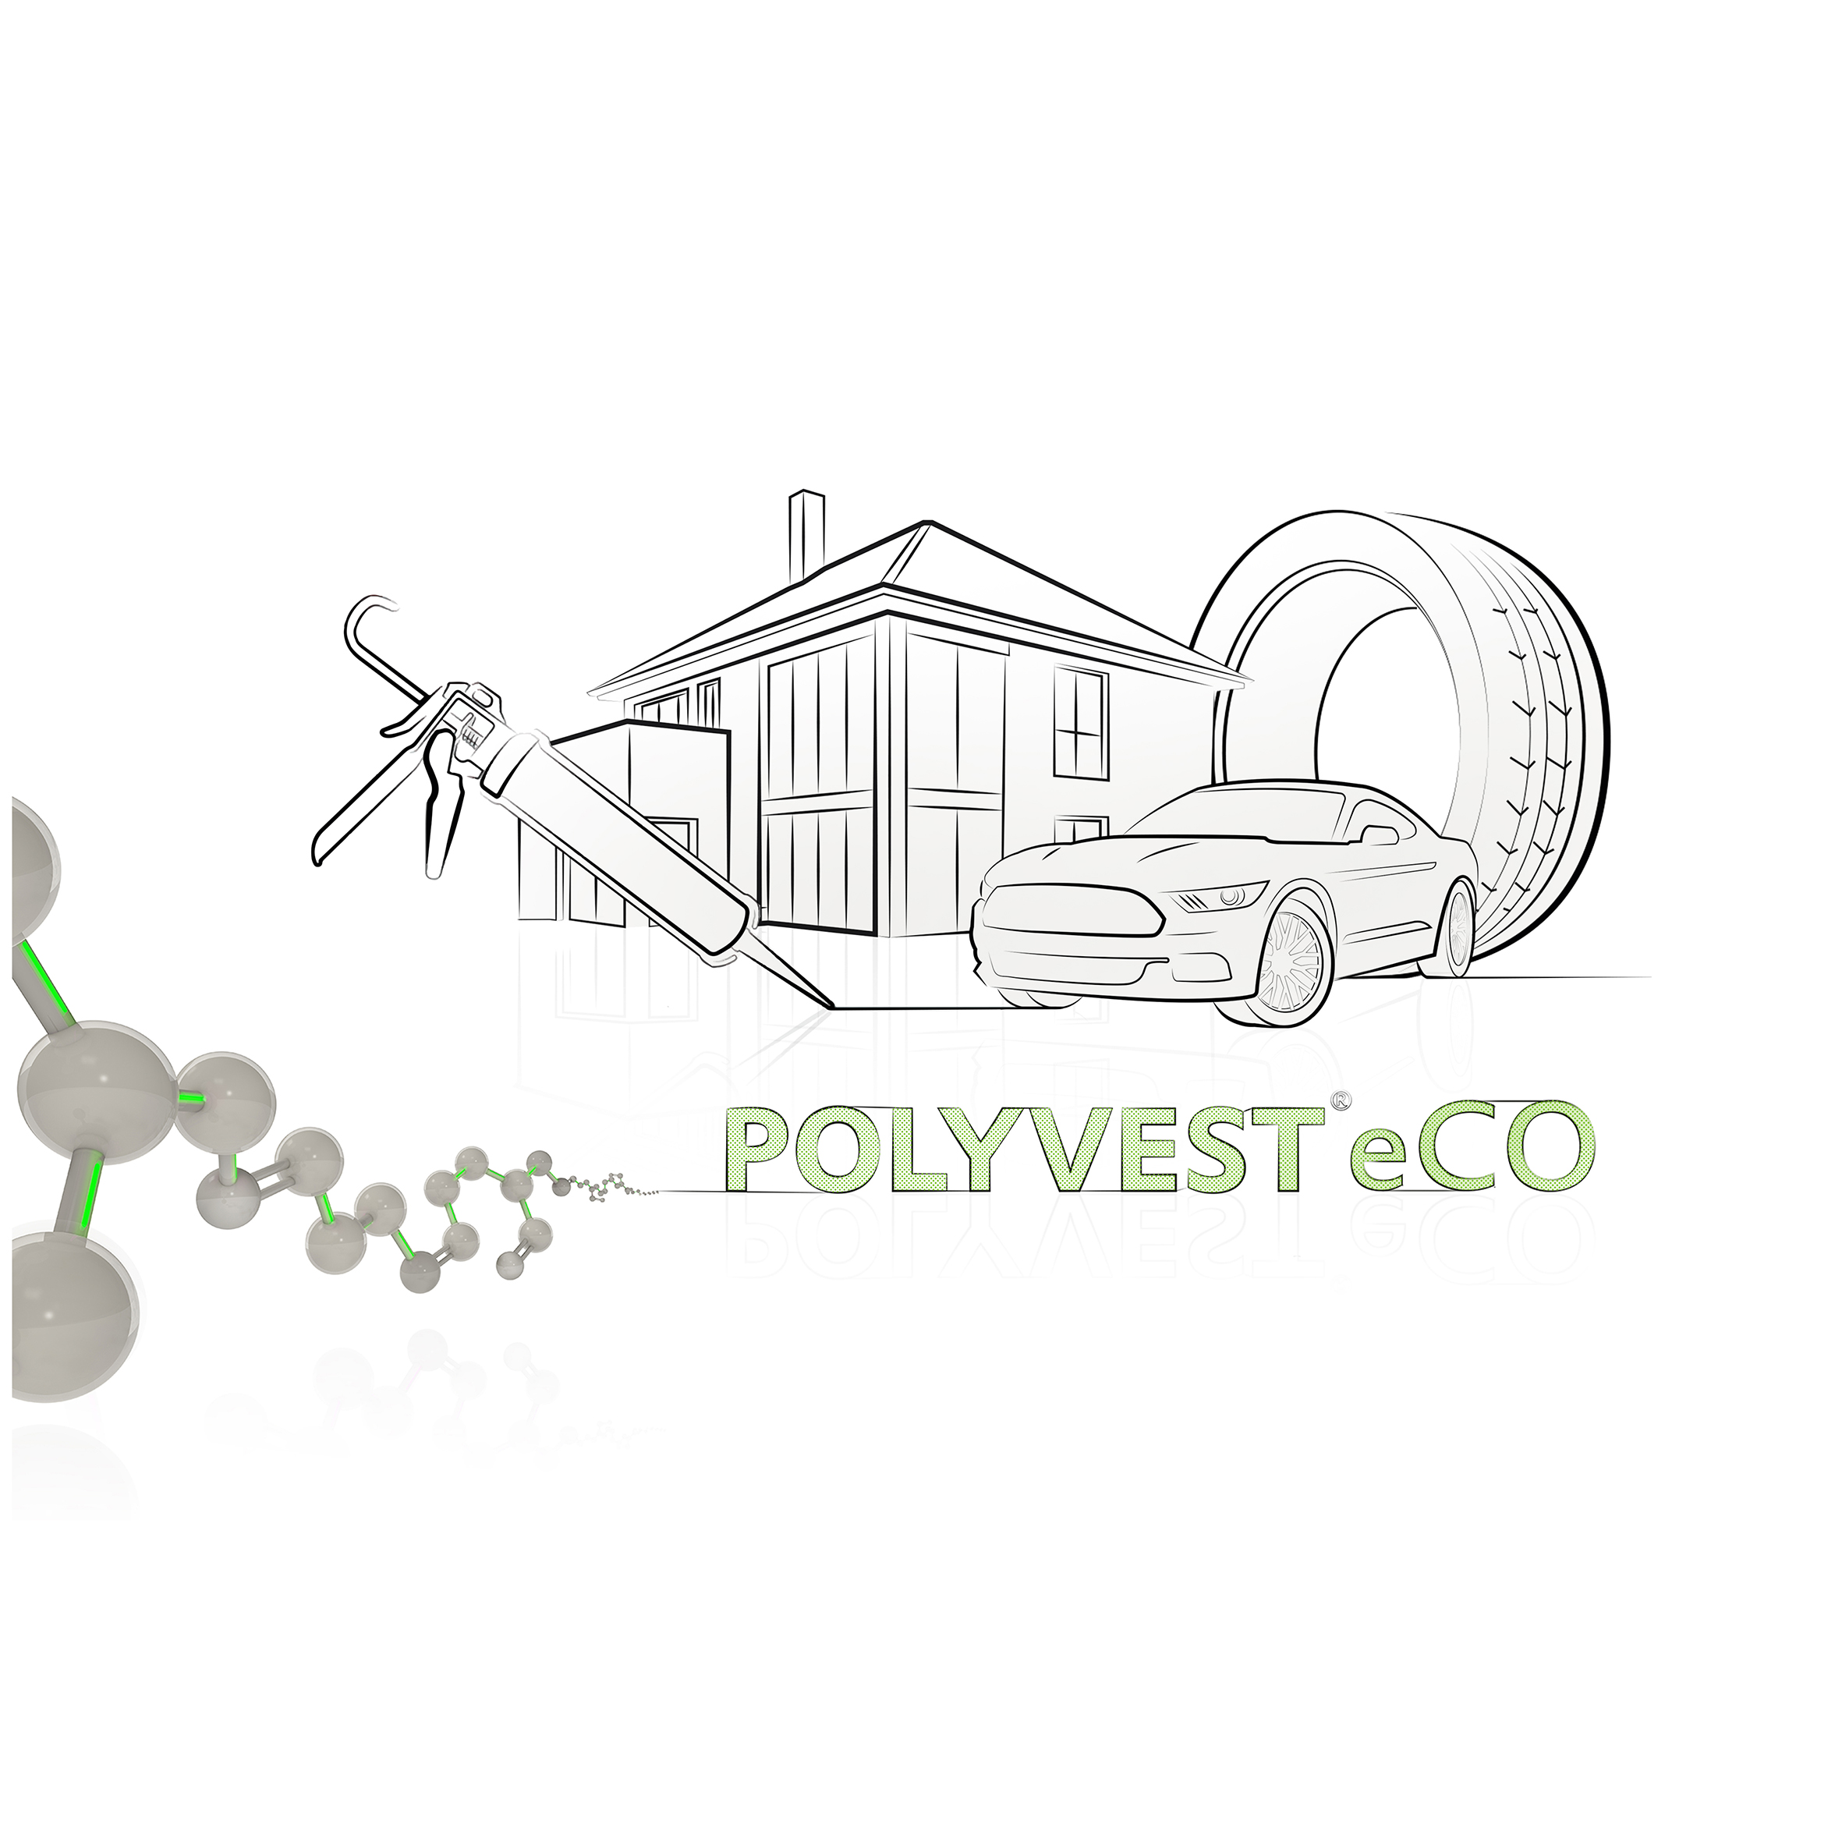

Slide 16
eCO products help to …
… reduce use of fossil feedstock
… reduce carbon emissions

Slide 17


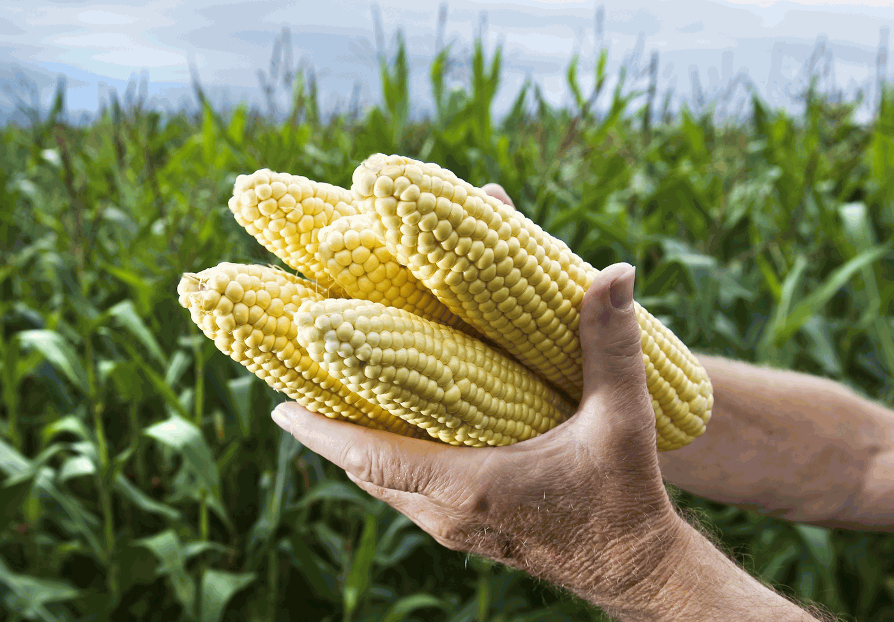
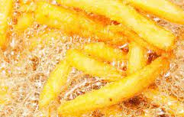
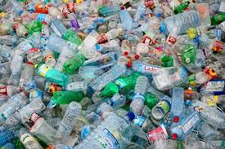
Alternative sources of feedstock
They make it possible to produce more sustainable products
Type of Feedstock
Fossil
Renewables
Bio
Bio circular
Circular
Virgin agricultural raw materials
Waste materials of biological origin
Waste materials of non-biological origin

Slide 18
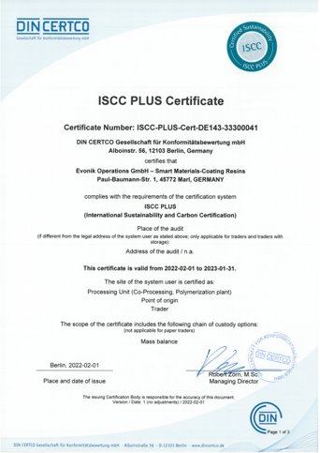

ISCC certified eCO products
Evonik is moving closer to achieve its Sustainability goals
eCO = eliminate CO₂
ISCC = multi-stakeholder initiative & member of the UN Global Compact
Globally leading certification system → addresses sustainability requirements for all feedstocks and markets
Provides traceability along the supply chain
Evonik’s eCO series combines all products that use a (certified) mass balance approach to lower their Carbon Footprint

Slide 19
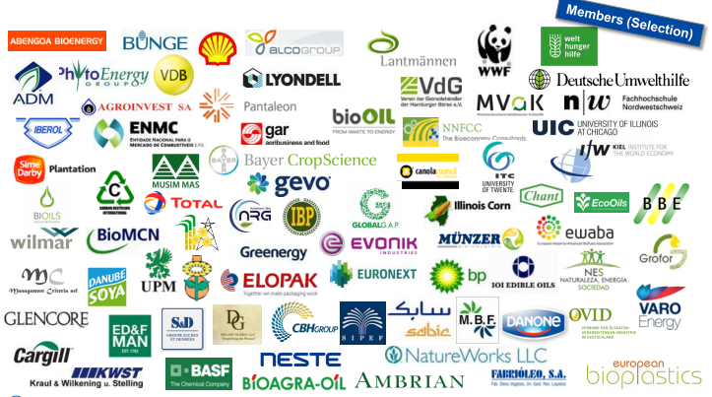
ISCC PLUS Certificate
International Sustainability and Carbon Certification
ISCC is well-established and recognized by many companies and organizations
What do they do?
Implementing social and ecological sust. criteria
Verifies predefined and transparent mass balance accounting
Monitoring deforestation-free supply chains
Avoiding conversion of biodiverse grassland
Calculating and reducing GHG emissions
Establishing traceability in global supply chains

Slide 20







The Mass Balance Approach
Fossil and sustainable raw materials can be used simultaneously in one plant
Mass Balance Approach at Evonik
Segregated in bookkeeping
Sustainable product through allocation

Slide 21




Mass balance process used in green energy
Similar to the process used in the chemical industry: Energy mix is fed to powerline
Same line for green & conventional energy
Green energy is allocated to extra-paying customers.
The usage of green energy is counted and balanced by the certificates of the supplier

Slide 22
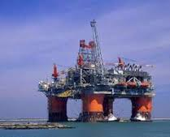



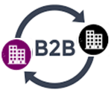


Transparency along the value chain
Each company along the value chain needs the certification
Initial feedstock
Raw material
Production plant
Distributors, Regional Warehouses, Traders, Reworking
Customers
End consumer
Fossil and/or renewable sources
To get ISCC certified, you have to buy ISCC certified raw materials
The certificate is site-dependent: each site has own certificate
Strict rules on communication of ISCC certification

Slide 23
POLYVEST® eCO
Smart liquid rubber solutions for a sustainable future
Certified by the ISCC (International Sustainability and Carbon Certification) since Feb. 2022
POLYVEST® eCO is produced in compliance with ISCC PLUS standards in a mass balance approach
Substitution of fossil based raw material up to 99,9%
Available for all POLYVEST ® grades (bio-based feedstock)
Identical properties as the traditional POLYVEST ® portfolio, which directly reflects in a drop-in solution with the well-known product performance but with reduced CO₂ emissions

Slide 24
POLYVEST® eCO is now available as Dry Liquid in the LUVOMAXX® portfolio

Slide 25
Agenda
Evonik
Business Line Coating & Adhesive Resins
POLYVEST® eCO
Q&A Session

Slide 26

Q&A Session

